Slide 1



Cache Controller Implementation with Write-Through Policy GROUP no.10
Groub Members:
Name | Track
Ehab Mostafa farghly | Design
Mohamed Mahmoud elfeki | Verification

Slide 2
Agenda
Block diagram
FSM
Test Cases
Integration With RISC-v

Slide 3
Block diagram

Slide 4
FSM

Slide 5
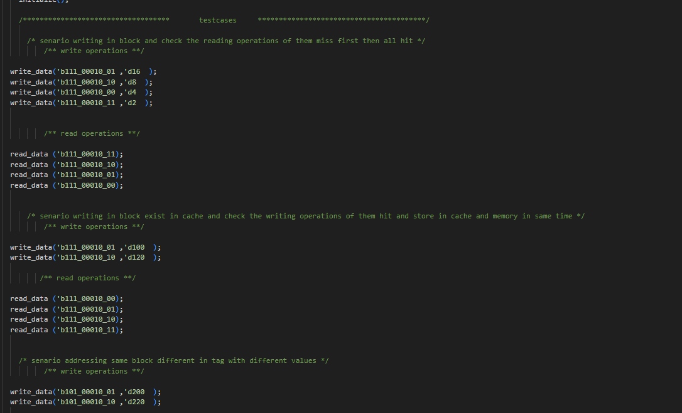
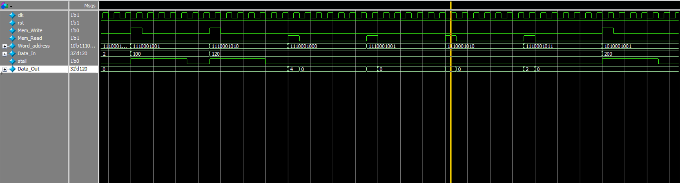
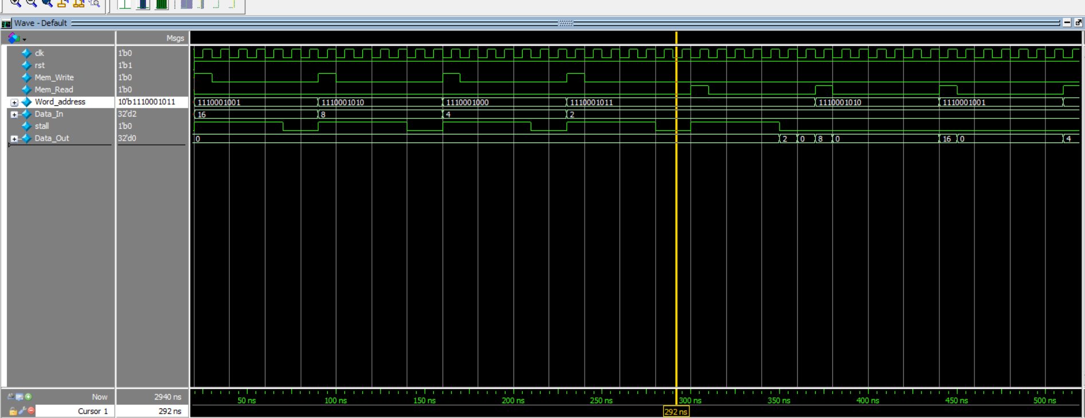
Test scenarios

Slide 6
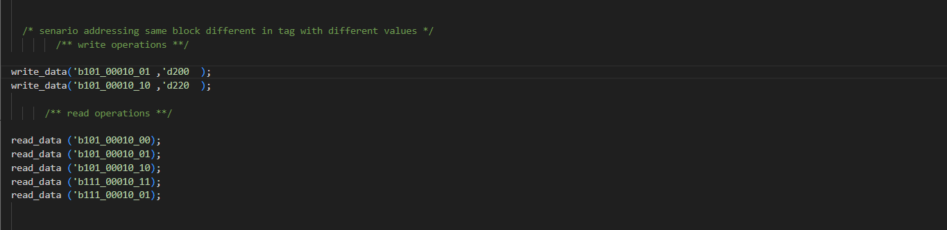
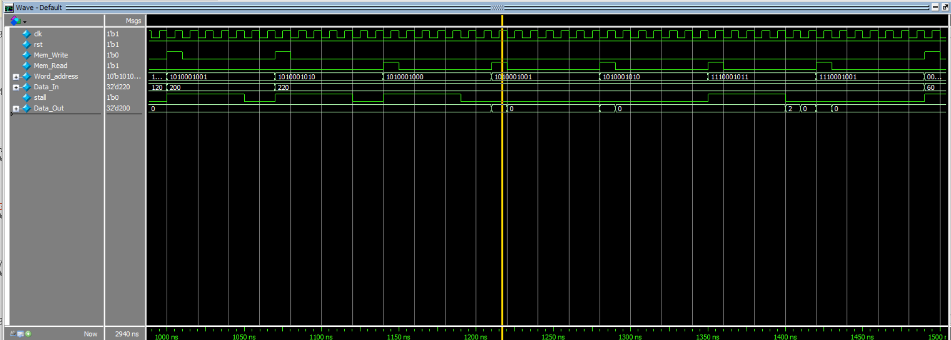
Test scenarios

Slide 7
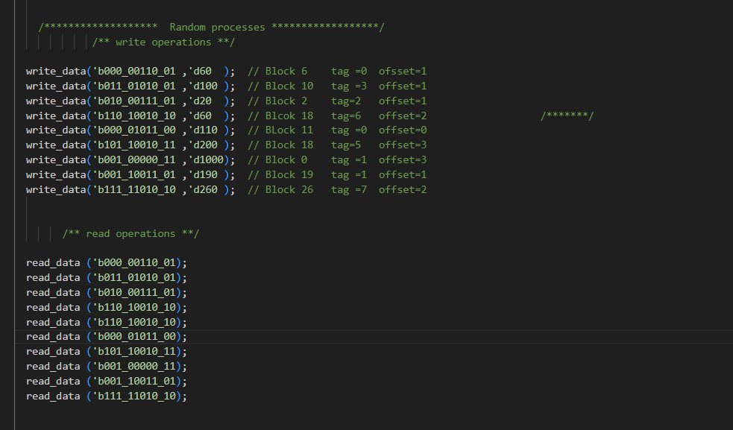
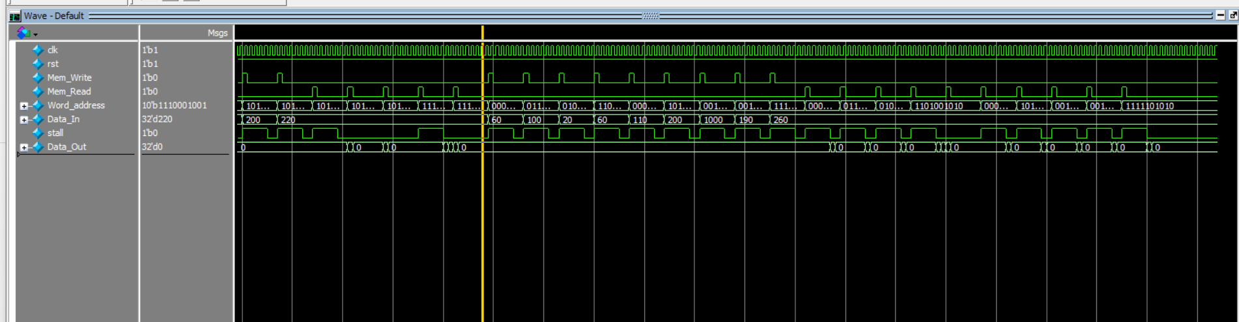
Test scenarios

Slide 8
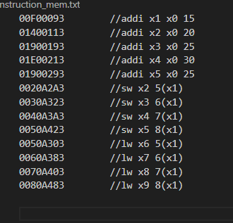
Integration with RISC V
Integration with RISC V needs small modification in control unit in RISC V and PC Counter in RISC V
We run program make various read and write to check that it works properly

Slide 9
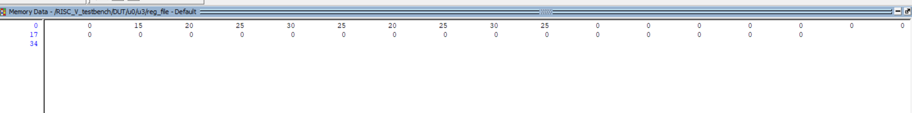
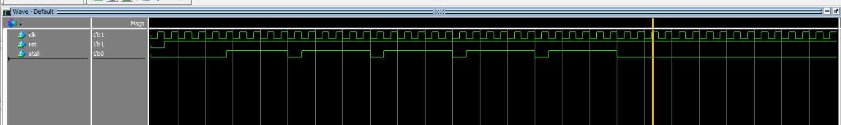
Integration with RISC V

Slide 10
Thank You!

